Slide 1
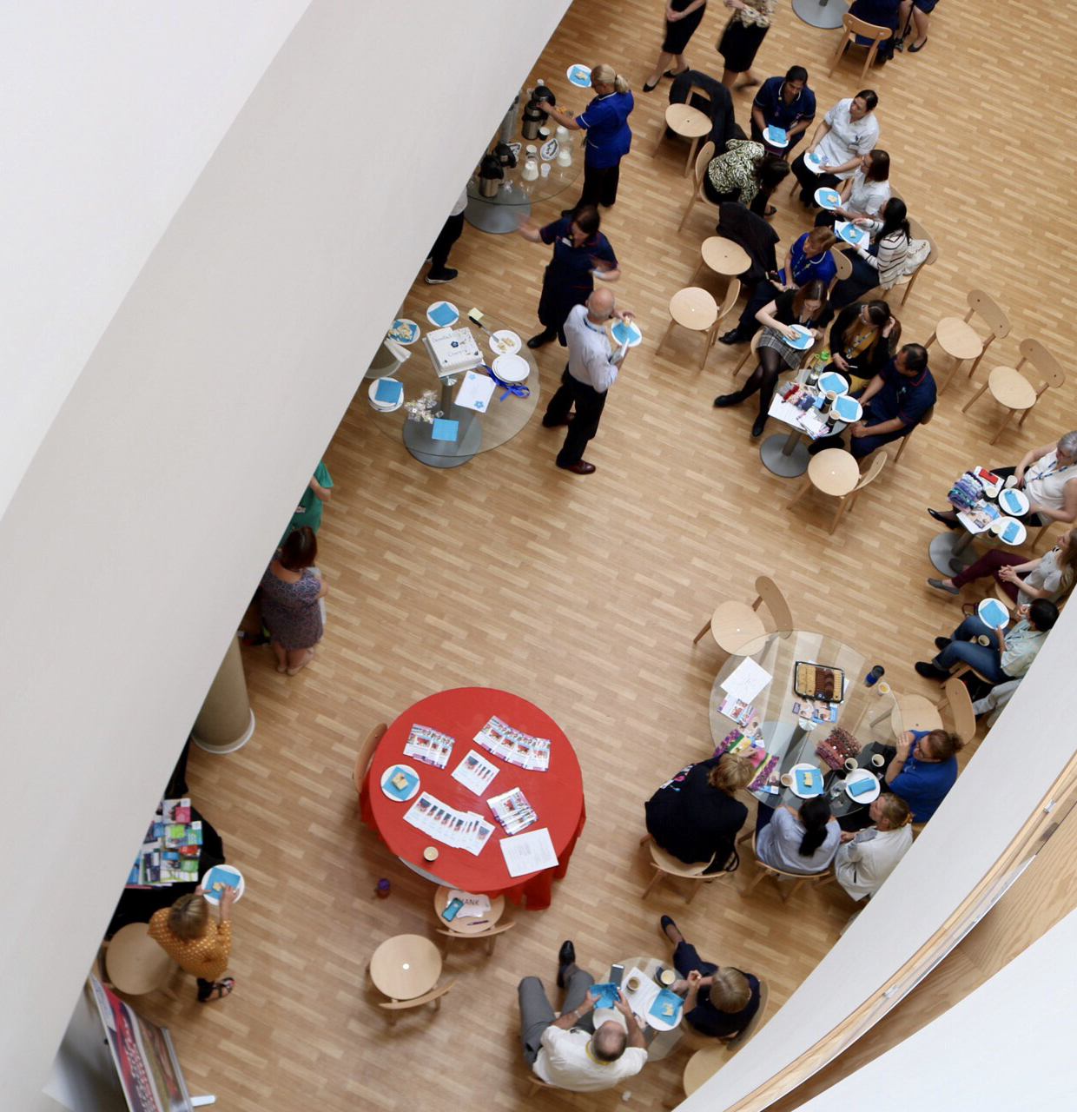
Supporting You

Slide 2
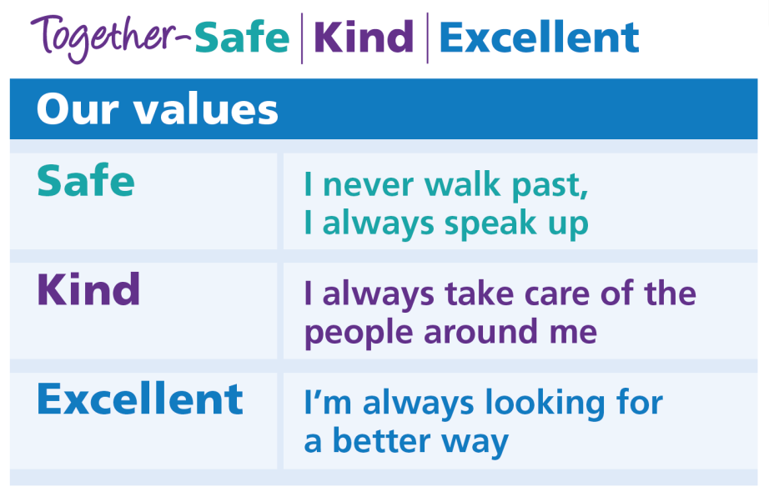
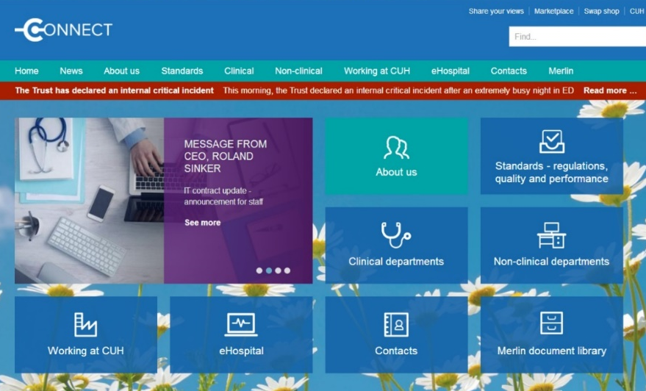
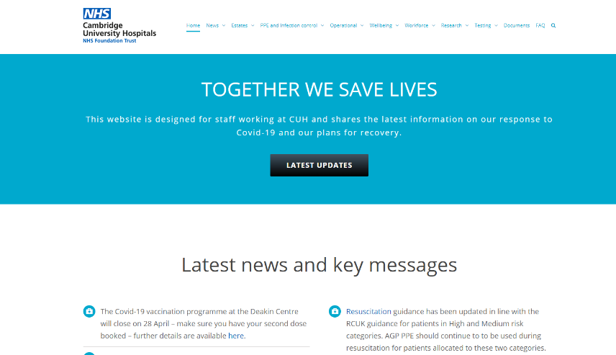
Supporting You
Notes:
We have already mentioned the Trust values of Safe, Kind and Excellent and we will focus on them a bit later on this morning.
You will have been emailed the CUH Benefits Booklet (sent in final offer of employment).
At CUH we want people to Start Well and Stay Well. This begins before you join your team – we hope managers have organised various logistics for you in advance such as how log on details for the Trust systems – if you don’t have these you should get them when you join the team.

Slide 3

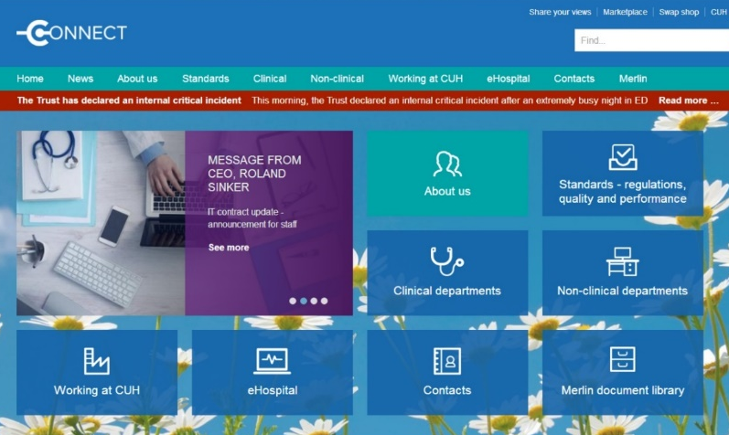
Communication with You
CUH Daily Bulletin
Staff Portal – cuhstaffportal.co.uk
Connect – Trust intranet
Wider Trust meetings – including monthly CEO Q&A
08:27 Tuesdays
Team Meetings
Noticeboards
Staff surveys
Notes:
CUH Daily – this is an e-mail that goes to all staff every day – it includes news and information that is beneficial to all staff members.
Connect – has everything you need to know about working here, departments and more…
Wider Trust meetings – there are frequent meetings that any staff members are welcome to such as quarterly CEO and Chair briefings as well as a weekly meeting on a Tuesday in the boardroom.
Team Meetings – we would expect all teams have get togethers at different times – some may be scheduled at specific times, others may be a daily handover meeting – however your team does it – it is a chance to find out what is going on in your team, your division and the hospital as a whole.
Some teams may also use noticeboards to convey information as well – this is something that will be discussed in your local induction.
Staff Surveys are one of the best ways for us to share our views about our jobs and the NHS. Senior managers in the NHS - both nationally and in our organisation - use results from this survey to improve care for patients and working conditions for staff.’

Slide 4

Support at Work
Notes:
Local Induction Your local induction should orientate you to your team and your area of work will be regular check ins with your manager or supervisor to talk about your progress and any support that is required – this is an important part of your support network – so if you are having challenges please do speak up about them with your manager.
Catch-ups - Your manager/supervisor should also provide you with regular input and at the end of your first 3 months there will be a 3 month review discussion with your manager – an opportunity for you to provide feedback about your progress, what has gone well, if you need any additional support or training, and to discuss key priorities for the rest of the appraisal year.
More details in the next slides

Slide 5

Staff Networks
REACH Staff Network
E&D Staff Group
LGBT+ Staff Network
Time to Change Network
Purple Network
equality@addenbrookes.nhs.uk to join the mailing list
Notes:
As mentioned earlier this morning by (executive), being a part of a staff network is a great way of ensuring your voice is heard, having an impact and being a part of positive change across the organisation, as well as being a safe space for staff to share concerns and support each other.
Here is a video explaining more fully.
https://vimeo.com/537689693/8190fde295

Slide 6

CUH Joint Working with Trade Unions/Professional organisations
The trust recognises a range of trade unions/professional organisations
CUH Staff Side are elected members of staff. They receive specialist training to undertake their role
CUH Staff Side support members across broad range of employment matters, representing staff interests and supporting them during any grievances, formal meetings or if staff wish to raise concerns
Regular meetings between senior management and CUH Staff Side – Management Staff Forum (MSF)
CUH Staff Side are key members of trust committees
If you wish to join, go to Trade Unions Connect page – found under ‘Working at CUH’
Notes:
The Trust recognises a range of Trade Unions/professional organisations.
The elected members of each of the organisations receive specialist training to undertake their role and they form CUH’s Staff Side.
Staff Side representatives support their members across a broad range of employment matters, representing employee’s interests and supporting them during any grievances, formal meetings or if staff wish to raise concerns.
They can advise on a wide range of employment and terms and conditions. Trade Unions also have a range of benefits linked to membership.
There is a regular meeting of senior management and Staff Side called the Management Staff Forum (MSF); the purpose is to work together on a broad range of issues that impact on staff such as strategy matters, organisational changes, policies and practices and staff engagement and development..
Staff Side representative are key members of the Trust’s Health & Safety Committee, Equality, Diversity and Inclusion, Workforce Experience Committee and Learning & Development Group.

Slide 7
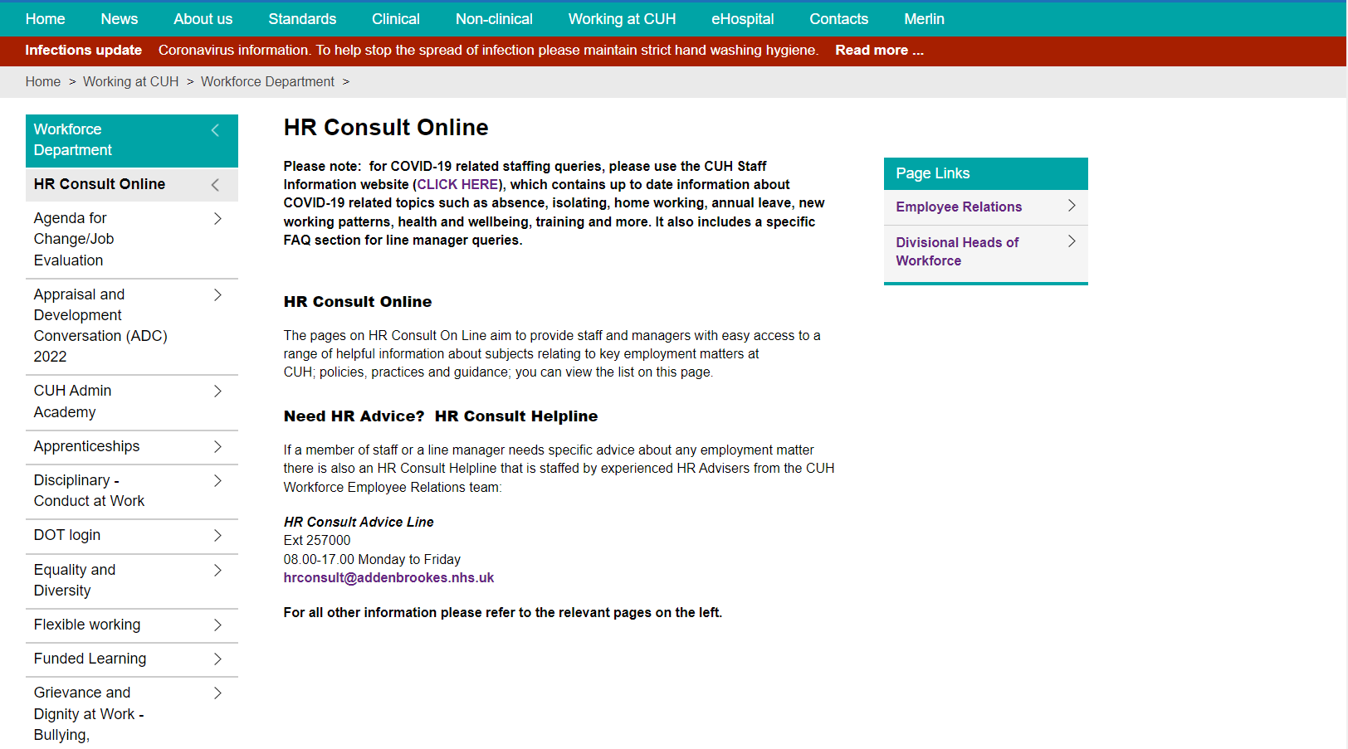
HR Consult Online
For all matters concerning employment.
01223 257000
hrconsult@addenbrookes.nhs.uk
Notes:
Employee Relations
The Employee Relations team is a professional HR support service. They provide advice to managers and staff members and work closely with staff side and trade unions.
For general HR issues and advice, then HR Consult is your first port of call and you can email or call them. Here is their page on Connect where you will find a range of information, advice and links, these cover all aspects of employment.

Slide 8
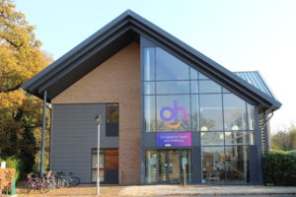
Occupational Health and Wellbeing
Self-referral Staff Physiotherapy Service
Improving and protecting workforce health
Providing an advisory service to all staff
Open Monday-Friday, 08:30 – 16:30
www.ohwellbeing.com
Ext 216767
Immunisations
Health & wellbeing information/advice/courses
Notes:
Self referal to physiotherapy – search Staff Physiotherapy
Off work with a musculoskeletal (MSK) condition
- At risk of being off work with an MSK condition
- Unable to perform their usual duties due to a MSK condition.
Protecting Workforce Health
Adaptations
Assessment
Health surveillance
Immunisation including asymptomatic Covid-19 swab testing.
The staff testing programme is a core pillar of the Trust’s strategy for keeping our staff safe and healthy.
All new staff in their first week to attend the Asymptomatic Staff testing kiosk (currently situated in the food court) to collect a swab pack and enrol in the asymptomatic staff testing programme.
Returning to work
Improving workforce health
Emotional health & Wellbeing
Weight management
Sleep well
Musculoskeletal issues

Slide 9

Mental and Emotional Wellbeing
Health Assured Ltd - a free 24 hour confidential advice, information and counselling service
Self referral to Staff Mental Health Service (SMHS) – provided by CPFT
Chaplaincy – including Schwartz Rounds
The purple passport
CUH Leadership support circles provided by Leadership
Development
Regional Staff Support Hub - provided by Cambs
& Peterborough ICS https://staffsupporthub.org/
For more information go to:
www.cuhstaffportal.co.uk or www.ohwellbeing.com
Notes:
Chaplaincy and Schwartz rounds
The Chaplains are members of staff employed by the Trust to care for the spiritual and pastoral needs of the whole hospital community. They are committed to care for each individual and to respect all people regardless of race, religion, creed, gender and culture. They provide the opportunity to talk in confidence about thoughts and feelings.
They are also involved in organising and facilitating the monthly Schwartz Rounds within the Trust: a multidisciplinary forum where staff can come together to share and discuss the experiences and challenges of their work at CUH. A representative will be here at break if you want to find out more.

Slide 10

Electronic Staff Record - MyESR
MyESR Employee Self Service gives every member of staff the access to manage their own personal information anywhere, anytime.
You must log in to your MyESR account to view and download your online payslips
MyESR gives you easy online access (from home laptop/PC or mobile device) to:
View, print and save your payslips, Total Reward Statement (including your annual pension statement) and P60
Check and update your own details including address, bank account, contact phone numbers, emergency contacts, and equality and diversity information
View your employment and absence history
Corporate Induction - MyESR

Slide 11

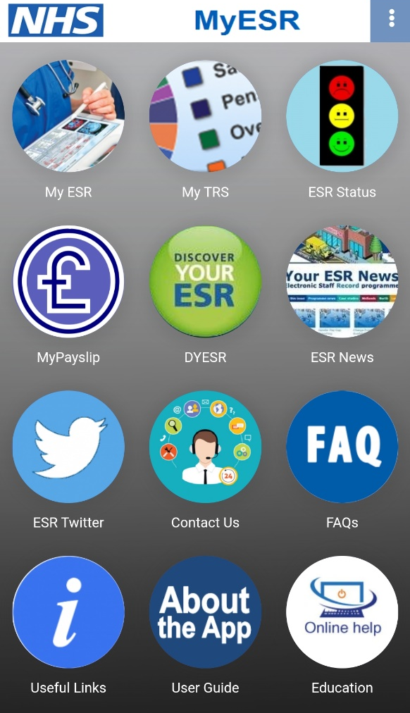
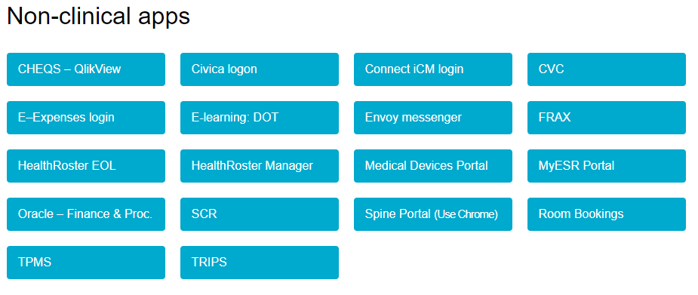
Electronic Staff Record - MyESR
MyESR app is available to download from the App Store or Google Play
You can also access MyESR via the Connect portal
or my.esr.nhs.uk
Corporate Induction - MyESR

Slide 12

Pensions
You are automatically joined into the NHS Pension Scheme from commencement in post
Find out about your NHS Pension Scheme, in the 2015 Member Guide on the NHS Pensions website - www.nhsbsa.nhs.uk/nhs-pensions
You do not pay income tax on the contributions you pay, and your employer contributes an additional 20.6% on your behalf
There are important benefits for members and their families:
    A pension payable for life – this is fully guaranteed by the government
    Flexibility in how and when you claim your NHS Pension
    If you become too ill to work, you may be able to apply early for an ill health retirement pension
    In the event of your death, family benefits are payable
  Keep track of your NHS pension through MyESR app.
  You can contact our pensions team on pension.services@addenbrookes.nhs.uk
  more details on Connect
Notes:
NHS Pension Scheme
You will automatically become a member of the NHS Pension Scheme from commencement in post. You can find out more about your NHS Pension Scheme, in the 2015 Member Guide on the NHS Pensions website.
You do not pay income tax on the contributions you pay and your employer contributes an additional 20.6% on your behalf
There are important benefits for members and their families:
A pension payable for life – this is fully guaranteed by the government
Flexibility in how and when you claim your NHS Pension
If you become too ill to work you may be able to apply early for an ill health retirement pension
In the event of your death, family benefits are payable
To help you keep track of your NHS pension, you have access to an annual benefits statement through your Total Rewards Statement (TRS) via the MyESR Portal. These statements are refreshed every year and are available for you to look at whenever you wish.
For more information about all of these benefits and the NHS Pension Scheme in general please visit the NHS Pensions website www.nhsbsa.nhs.uk/nhs-pensions
For all the latest NHS Pension news don’t forget to sign up to the NHS Pensions member newsletter. You can do this in the Member Hub on the website. You can also follow NHS Pensions on Twitter @nhs_pensions
For any further queries, you can also contact our pensions team at pension.services@addenbrookes.nhs.uk

Slide 13
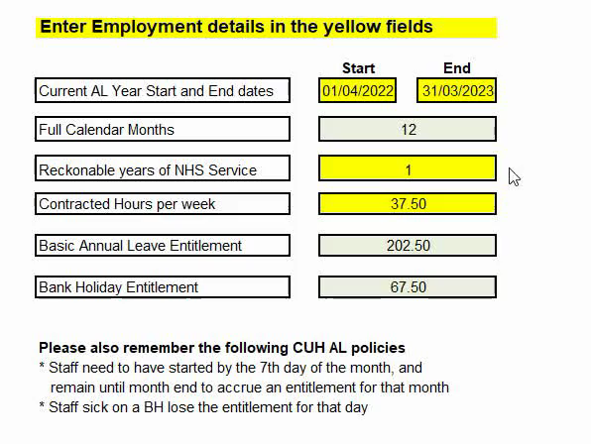
Leave Entitlement
Entitled to paid annual leave and entitlement to public holidays (usually 8 days a year).
Annual leave is calculated in hours
Previous NHS service counts – check with your manager if this is the case
Opportunity to purchase up to 12 weeks additional leave.
Other key leave schemes:
    Carers leave (for child, dependent, elderly care)
    Maternity Leave, Adoption leave and paternity leave
    Special time out scheme
Annual leave calculator
On appointment | After 5 years service | After 10 years service
202.5 hours (27 days) | 217.5 hours (29 days) | 247.5 hours (33 days)
Notes:
Annual Leave
You are entitled to paid annual leave and also entitlement to public holidays (usually 8 days per annum).
Annual leave is calculated in hours this is because of the varying shift patterns/hours worked and for our staff that work part time or flexibly.
If have previous NHS service prior to joining CUH this counts towards your years of service; this can include service that you may have had some years ago if you have had a break in NHS service.
Do alert your line manager if you think you are entitled to extra annual leave for other NHS service.
Other key leave schemes:
Carers leave (for child, dependent, elderly care)
Maternity Leave, Adoption leave and paternity leave
Special time out scheme
Annual leave purchase scheme

Slide 14
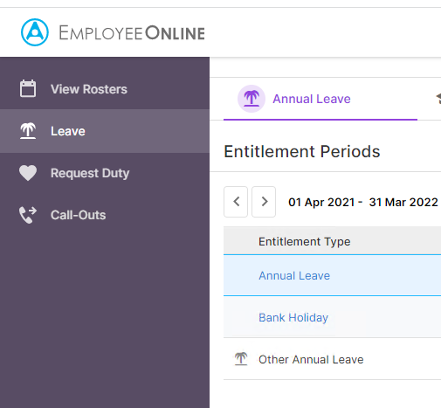
Healthroster:
(MAPS) - E rostering and absence reporting
(EOL) – Employee online
Healthroster manager (MAPS) - used for entering absence data, producing rosters and run reports
Healthroster (EOL) - all staff see own roster, request annual leave
Accessible from anywhere
Need nhs email to register - Please email (from your own nhs.net email account) roster.support@addenbrookes.nhs.uk to request your username and password.
Guides on how to use MAPS/EOL are found on Connect page - Healthroster (MAPS) E-Rostering and Absence reporting
Notes:
EOL - staff use to see their rosters, manage their Annual Leave etc online. It is accessible through Connect2, or offsite via home computers or mobile devices.
If you are a new starter please email roster.support@addenbrookes.nhs.uk from an addenbrookes.nhs.uk or nhs.net email account to request account activation. This is not an automated action, so you will need to wait for your log on details to be sent back to your email account. Logins can only be sent to NHS email addresses.
To activate your own page EOL for seeing your roster and requesting leave; please email (from your own nhs.net email account) roster.support@addenbrookes.nhs.uk to request your username and password. Your email is used to generate the information.
Guides on how to use your pages are found on Connect here http://connect2/article/3494/Employee-Online-Guides

Slide 15
RotaWatch
On-call contact roles and information (live now, past and future) covering over 90 teams and services within the Trust
Accessible by all staff
Found under ‘Clinical Apps’ on the front page of CUH Portal.
Regularly updated by teams to ensure accurate and up-to-date
Information and guides on Rotawatch page on Connect
Notes:
Rotawatch is your first point of contact for on-call contact information covering over 90 teams and services within the Trust and growing!
Rotawatch can be accessed by all staff within the Trust and is found under ‘Clinical Apps’ on the front page of CUH Portal.
Users can find contact information for on call roles live now, later that day and any date in the past or in the future.
Information is maintained directly by each department to ensure Rotawatch holds the most accurate and up-to-date information.
If your role requires you maintain your teams information in Rotawatch, information and guides can be found by searching for ‘Rotawatch’ on Connect to find our information page.

Slide 16
Your development matters
Corporate Induction and role specific induction training (nurses, midwives, AHPs, ODPs and health care support)
Preceptorship programmes for newly qualified staff
Mandatory training and regular refreshers
Regular catch ups/1-1 discussions with your line manager and 3 month review meeting
Annual appraisal conversation including your personal development plan
Access to a range of internal training and development programmes, workshops and events for your development
    Apprenticeships, Functional Skills, routes into nursing
Funding for Learning – provides access to external training and development
Trust learning and development teams to support you;
    Nurse Education, Care Team, Learning & Development, Leadership and Organisational Development
Notes:
Your Development Matters
Corporate Induction and local induction
Role specific induction training (nurses, midwives, AHPs, ODPs and health care support)
Preceptorship programmes for newly qualified staff
Mandatory training upon commencement and regular refresher
Regular catch ups/1-1 discussions with your line manager
3 month review meeting to check in with you
Annual appraisal conversation including your personal development plan
Access to a range of internal training and development programmes, workshops and events for your development
Access to external training and development and funding
There are learning and development teams that can support you
Practice Development teams Your Practice Development teams are there to support you in your practice – they may run group sessions or 1:1 coaching. They aim to help you to gain more confidence in your role. They may also shadow you in practice and give feedback and guidance. They predominantly support new starters but are there to help develop competence in all staff and may also support study days and mandatory training. If you work clinically it is good to get to know these colleagues as they can provide invaluable support to you in your role.
Apprenticeship routes: CUH is proud of its range of apprenticeship programmes – routes for those new to work as well as experienced colleagues that want to undertake further training. These include programmes at degree and masters level. Programmes provide access to professional registration into nursing, allied health professionals, science, pharmacy and management routes.
We provide support and access to functional skills (maths and English) for those that would like to improve their skills or where these provide access to further development.

Slide 17
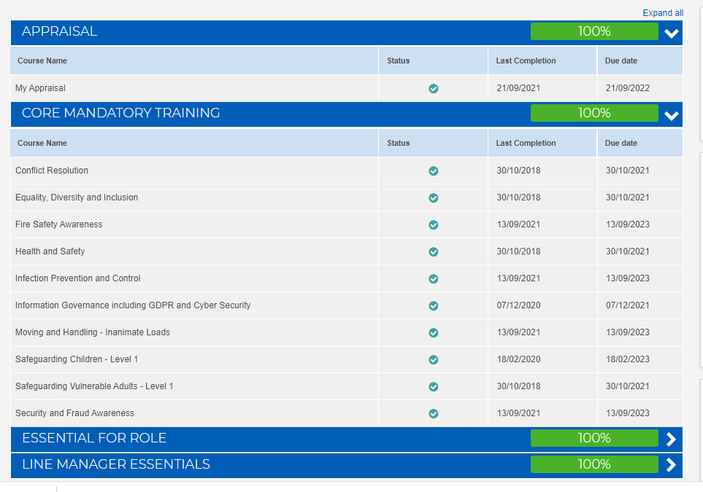
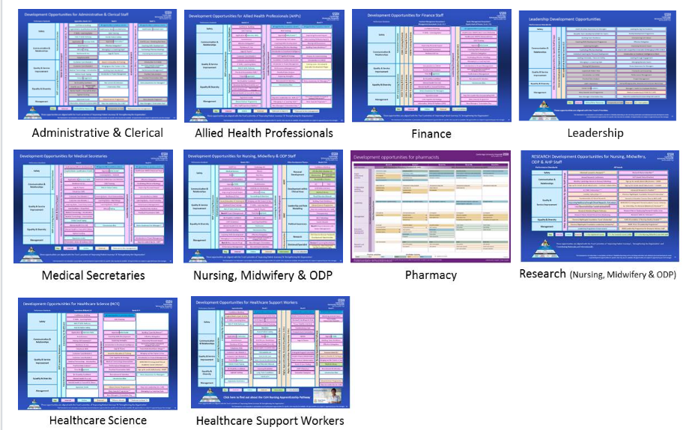
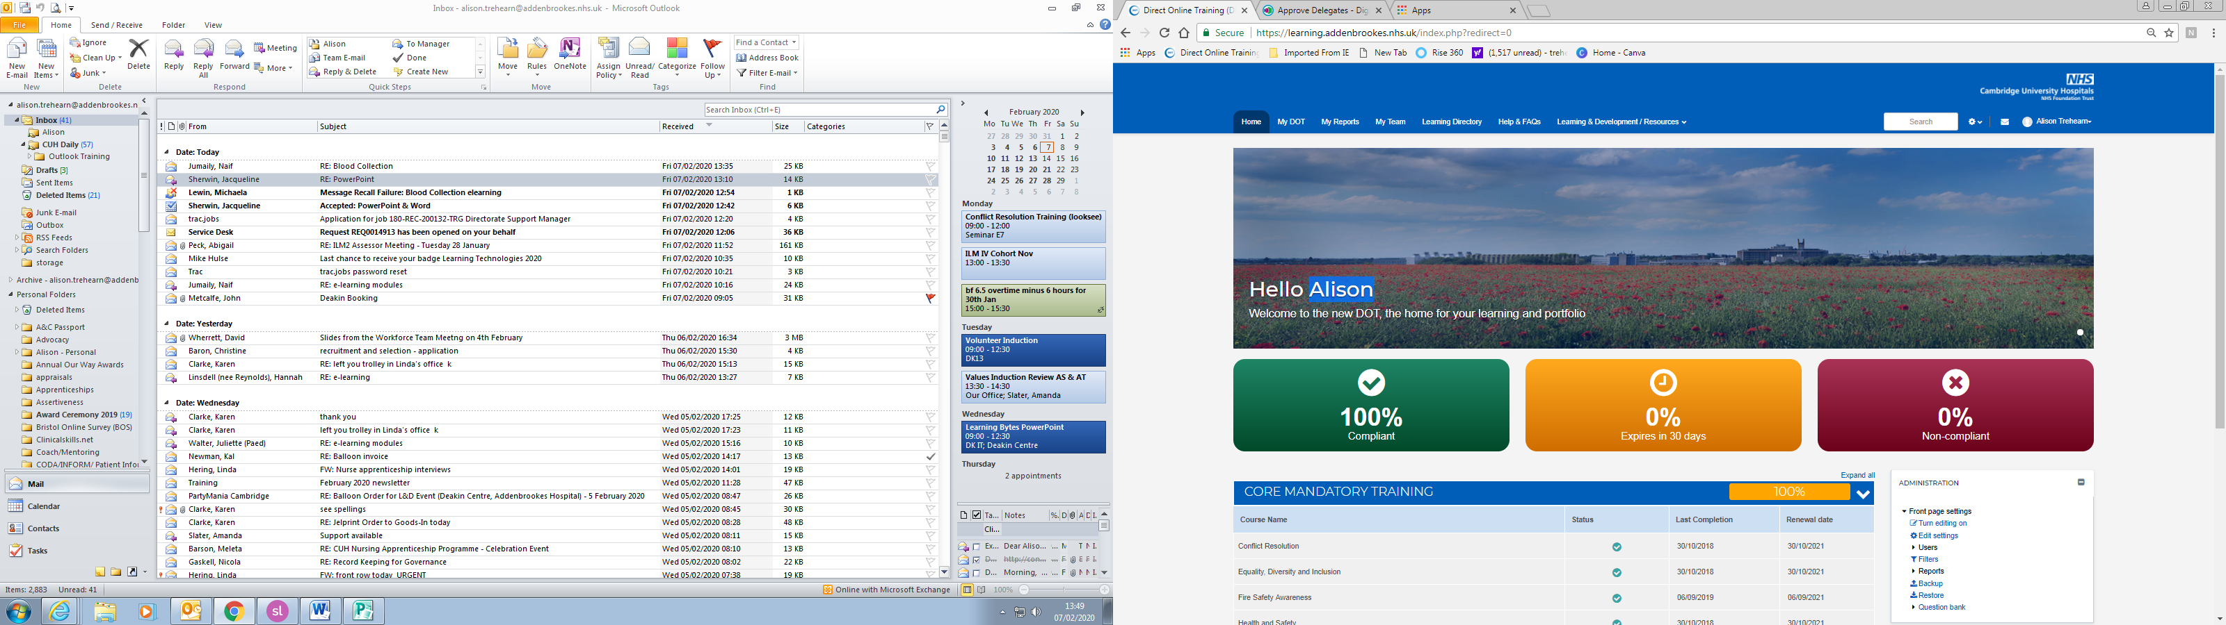
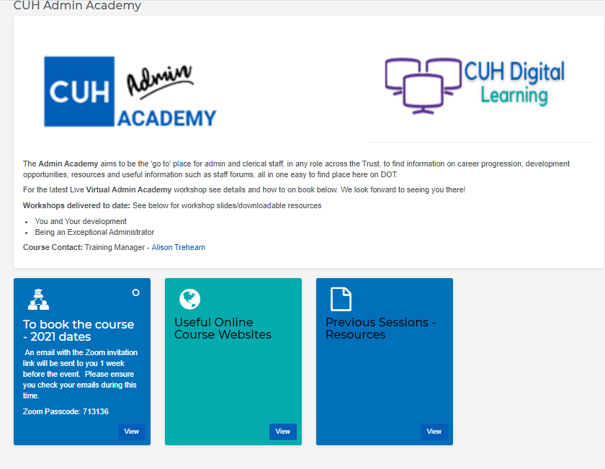

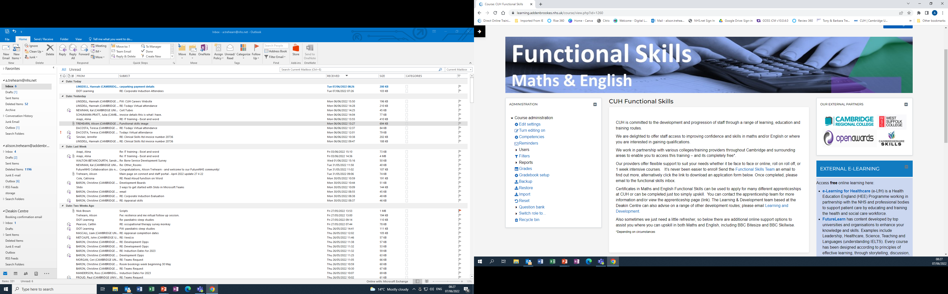
Mandatory & Essential for Role Training
Development Opportunity Boards
DOT
Book courses & workshops
Functional Skills
Notes:
Our on-line education/training system and facilities
DOT Provides you with access to your own training records. You can also
View the CUH learning directory…..
Book training
Gain further information about financial support for training if this is required
Development Opportunity Boards –
All staff can access the on-site library based in the CUH Clinical School – its there for all staff. It also provides a quiet environment and access to computers and IT
Facilities for staff training: this includes a number of education/training rooms, the Deakin Centre, mandatory training suite and a mandatory training room with access to computers/IT open 24/7

Slide 18
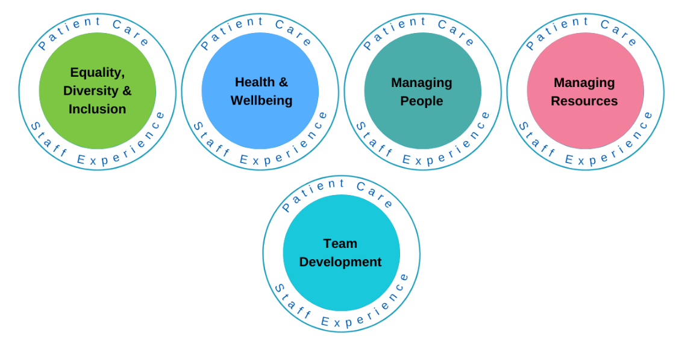
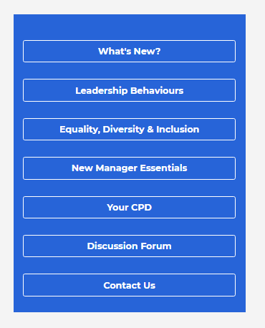
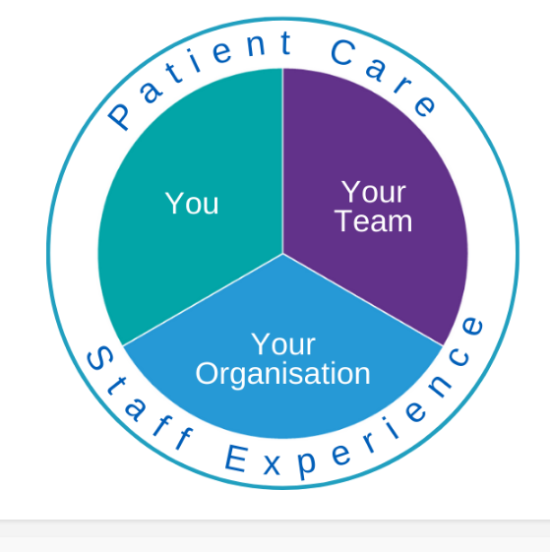
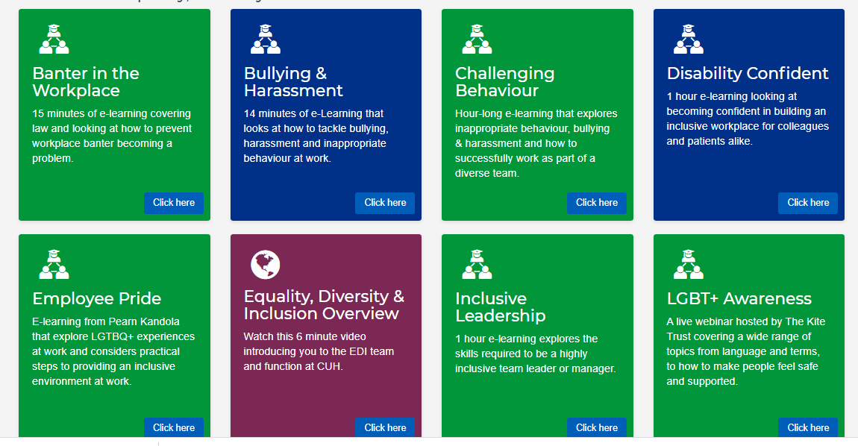
Manager Hub
Your Team
Edit Master text styles
  Second level
    Third level
      Fourth level
        Fifth level
Click on each section.
Notes:
We would like to draw your attention to a new resource – The Manager Hub – for all leaders and managers at CUH.
Based on DOT you can access it easily through the top blue toolbar.
View the introduction to read about what it is.
If you are a new manager there is a ‘New Manager Essentials’ section tailored to you.
For existing managers you can access all you need to develop yourself, your team and your knowledge of the Trust by choosing ‘you, your team or your organisation’ from the landing page circle.
If you are an aspiring manager this can be a great resource to help you on your career path too.
There are then different topics under each heading, that take you through to links for development that you can read (web pages, blogs etc), watch (videos, recorded webinars) or take part in (live training sessions, interactive e-learning etc).
It makes development for yourself easy and quick to access in the flow of work or at a time to suit you.
Have a look around!

Slide 19




Transport and travel hub
Rail Travel
Discount tickets and bulk buy scheme
Season ticket loan scheme
Bus Travel with Stagecoach
30% discount (QR code on cuhstaff portal)
Free travel between Cambridge train station and CUH on services (P&R and Citi services)
Car Travel
Park and Ride sites with free parking
CUH Liftshare Scheme
Lease a brand new car through the Car Lease salary sacrifice scheme*
Cycling
Cycle to Work salary sacrifice scheme*
Campus Cycle Hub - repair and service workshop
Mobikes and e-bikes – available to hire
Secure cycle lock-ups
Showers and lockers available (near Access office level 1)
Motorbike/Moped/Scooter
Interest free loans for new bikes and accessories
Local outlet discounts
Greater Cambridge Partnership - projects
* Watch the video - Salary Sacrifice Scheme on the Corporate Induction page on DOT
Notes:
The following will be available in addition to the free bus travel between the Babraham and Trumpington Park and Ride sites and CUH:
Free travel between Cambridge train station and CUH on Stagecoach services (P&R and Citi services). This can be accessed by showing your CUH staff badge. This discount is not offered on services provided by other bus companies.
An additional 15% discount on top of the existing Stagecoach offer, giving CUH staff a 30% discount on Stagecoach services. This discount can be accessed using the existing QR code available on the staff portal.
Stagecoach has reminded its drivers about these additional discounts, and that stops on the busway between Trumpington P&R and CUH are also included as part of the P&R ticket that CUH staff get for free.

Slide 20

Childcare support
On site day nurseries:
CUH has two on-site day nurseries, Bunnybrookes and Long Road (Mondays-Fridays) and other nurseries around Cambridge. These are operated by Bright Horizons, call 0370 218 6609.
Latest information on childcare is on Cuhstaffportal and Connect.
Salary Sacrifice Scheme* to support payment of nursery fees.
*For more information on how Salary Sacrifice
works, watch the video on the
Corporate Induction page on DOT
Notes:
On site day nurseries:
CUH has two on-site day nurseries: Bunnybrookes and Long Road (Mondays-Fridays)
They are operated by Bright Horizons. They are popular and depending upon the requests there may be a waiting list. Bright Horizons can advise on their other nurseries around Cambridge. More information from CUH Childcare Coordinator.
Latest information is available on CUHStaff Portal - https://cuhstaffportal.co.uk/workforce-2/leave/childcare/
CUH participates in the government tax efficient salary schemes – this means that you will pay less tax – pay before tax and NI is taken off.

Slide 21

Discounts
Health Service Discounts – www.healthservicesdiscounts.com
A variety of discounts for NHS Staff including Travel, shopping, insurance, finance, mobiles, motoring, TV & broadband, lottery.
Blue Light Card – www.bluelightcard.co.uk
Discounts online and on the high street. App and card.
Discounts for Staff – see latest offers on Connect/CUH Bulletin.
Notes:
Health Service Discounts
Health Service Discounts arrange a variety of discounts and offers on behalf of all NHS staff with many national companies including Vision Express, Radley, Acer Computers, Sharp Electronics, Goldsmiths and Oasis.
They also provide options to buy vouchers at a discounted price in advance of your shopping trip. Many national retailers including WH Smith, Marks & Spencer, BHS and Debenhams offer this scheme.
Visit the link below to enter their site, enrol now and start saving instantly.
Blue Light Card
Sign up to Blue Light Card discounts for offers on the High Street, as well as internet discounts and cashback.
With this card you will be able to get discounts without having to remember your Addenbrookes ID card when you want to shop! This will give you an app to be able to download to review things when you’re out and about!
5 year membership costs £4.99 – At Cineworld in Ely – I paid £ £6.61 for a £12.10 ticket
Local Benefits – see the discounts pages on Connect for more information – this gives information about some of the discounts available around Cambridge – they are often announced on CUH Daily but can be viewed on Connect at any point. MyCUH+ -the app allows CUH staff to view discounts and benefits while out and about, without access to Connect.

Slide 22
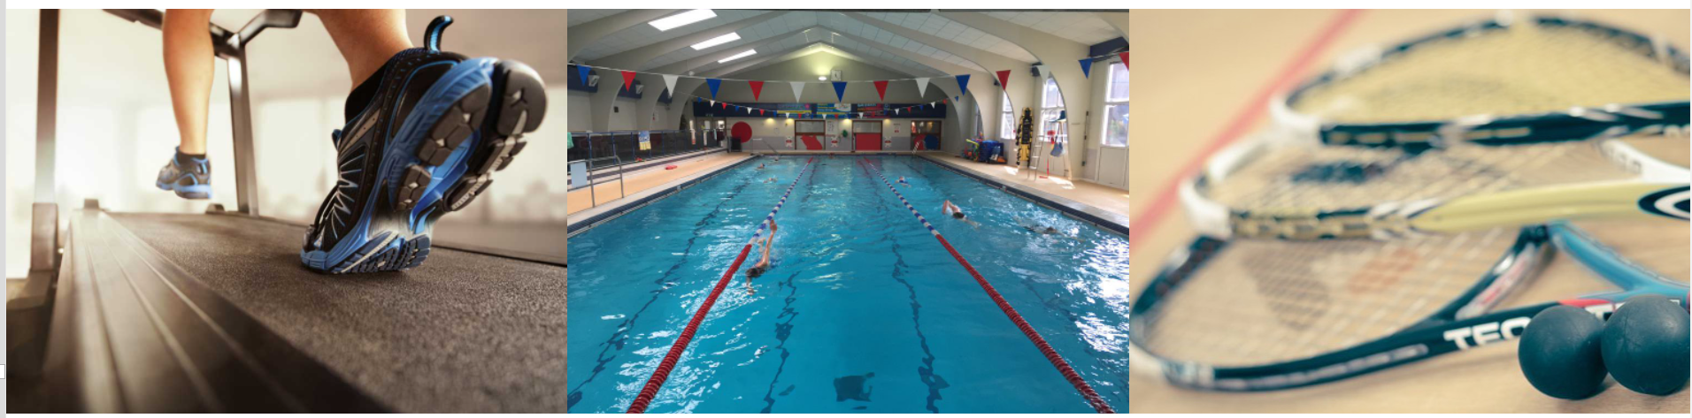
Physical Wellbeing
The Frank Lee Centre – membership options, swimming pool, racket courts, bar area, fitness classes and clubs and groups for adults & children, beauty clinic and osteopathy, Sta @ Frank Lee - www.frankleecentre.co.uk. Free taster sessions.
Visit Connect page - Social groups and Classes
Notes:
Stronger Together – social groups and classes
Campus Sound choir
Craft Group
Lunchtime walks
HODS Hippos – running club
Lindy Hop (currently postponed)
Meditation session
Pilates & Ti Chi classes
‘Its not just you’ support group
Cambridge Global Health Cafe

Slide 23
Cambridge Campus On Site Facilities
Main Concourse
    ATM machines
    Barclays Bank
    Body Shop
    Costa Coffee
    Hairdressers
    M&S Food
    Newsagent
    Solicitor
    Stock Shop (clothes and gifts)
  Out-patients
    ATM machine
    Lloyds Pharmacy – inpatient prescription service only
    RVS café
    Newsagent
Staff eating/refreshment areas:
Food Court – Main hospital
  Costa Coffee, Coffee Club
  Spice of Life, Burger King
  Designated Staff Area
RVS Café - Outpatients and the Rosie
Coffee Pod – Addenbrooke’s Treatment Centre (ATC)
The Green (between Royal Papworth & CUH)
Notes:
On site facilities
Staff eating/refreshment areas:
Concourse café’s and restaurants including xxxx staff only area
Sta @ The Frank Lee Centre
Royal Voluntary Service Café’s - Outpatients and the Rosie
(RVS gift monies to CUH for patient benefit from their income)
The green…. – have vans…..
Shops in the concourse and in out patient

Slide 24

Useful links
DOT login - www.learning.addenbrookes.nhs.uk
Webmail - https://mail.addenbrookes.nhs.uk/owa
https://portal.nhs.net/home/login
MyESR - https://my.esr.nhs.uk/dashboard/web/esrweb
Health Roster - roster.support@addenbrookes.nhs.uk
Staff Information - www.cuhstaffportal.co.uk
Occupational Health - www.ohwellbeing.com
HR Consult - hrconsult@addenbrookes.nhs.uk
NHS Pension https://www.nhsbsa.nhs.uk/
NHS Staff Discounts - www.healthservicesdiscounts.com
www.bluelightcard.co.uk
Frank Lee Leisure Centre - www.frankleecentre.co.uk
Notes:
These will be emailed to you after this morning’s induction.

